Slide 1
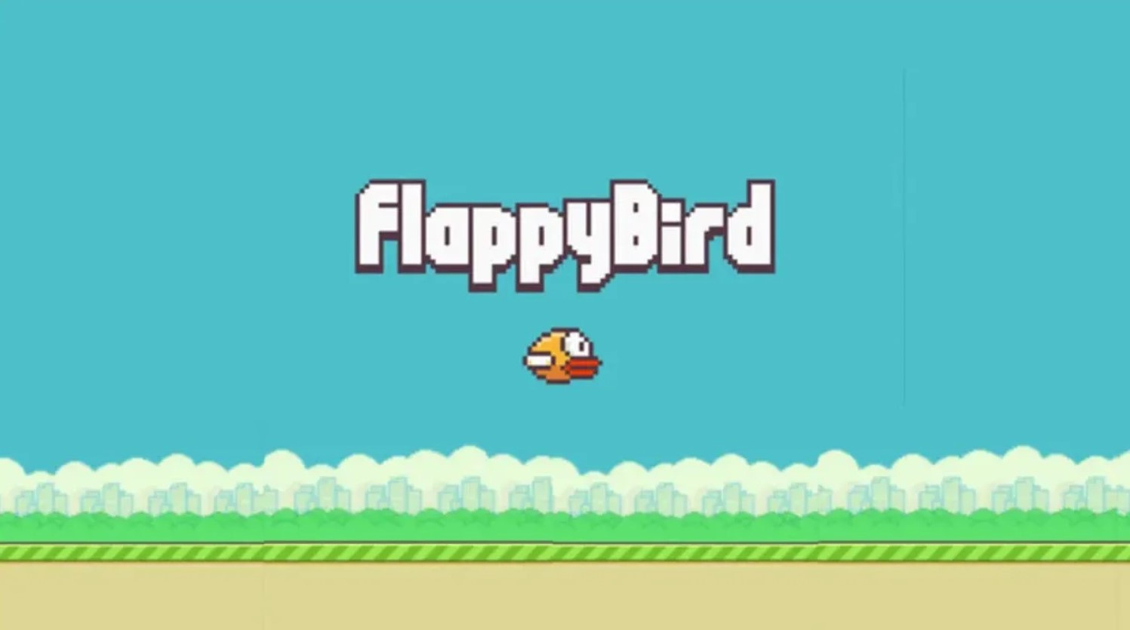
APP – PROJECT
FINAL REVIEW

Slide 2
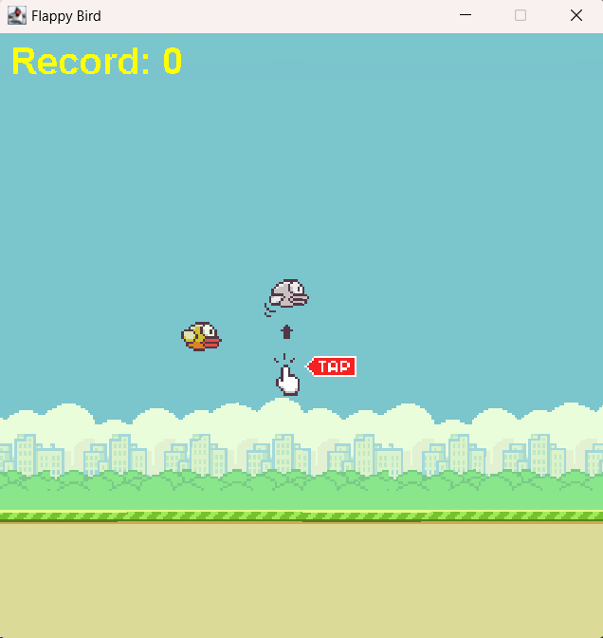
introduction
Flappy Bird is a simple yet addictive one-button game where you control a bird by tapping the screen or pressing the spacebar. The goal is to fly the bird as far as possible without colliding with green pipes. It gained immense popularity due to its challenging gameplay and minimalist design..

Slide 3
Game play mechanics
Flappy Bird is a touch-based mobile game with straightforward mechanics and aesthetics. Here’s a summary of its gameplay:
Objective: Navigate a bird avatar named Faby through pairs of pipes.
Controls: Tap the screen to make Faby flap its wings and ascend. Release to descend.
Scoring: Successfully passing through a pair of pipes awards one point.
Challenge: Avoid colliding with pipes or the ground to keep the game going
Remember, simplicity is key in Flappy Bird – just tap and flap! 🐦✨

Slide 4
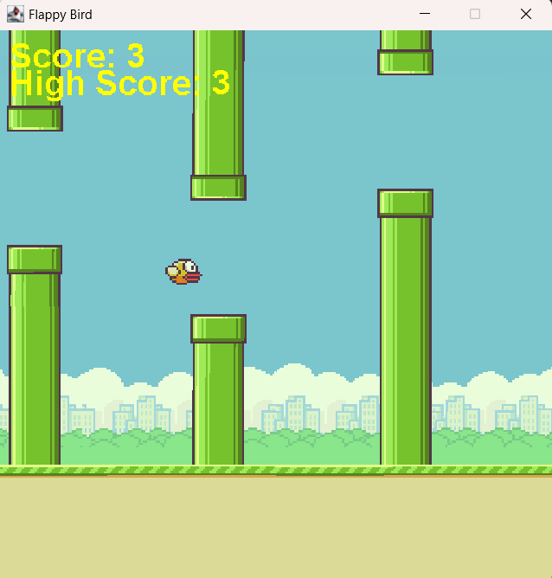
development
Creating an addicting game like flappy bird requires mid level java concepts and requires the user to be thorough with the beginning topics of java. It involves understanding of arrays, random number generation, strings, loops, detection etc.
Many mechanics of the game in check by these structures.

Slide 5
Project outcomes
Technical Outcomes
Educational Outcomes
Personal and Professional Outcomes
Complete Game Implementation
Enhanced Programming Skills
Game Development Knowledge
4. User Interface Design:
Problem-Solving Skills
Algorithm Development
Software Development Practices
Portfolio Enhancement
Increased Confidence
Creativity and Innovation

Slide 6
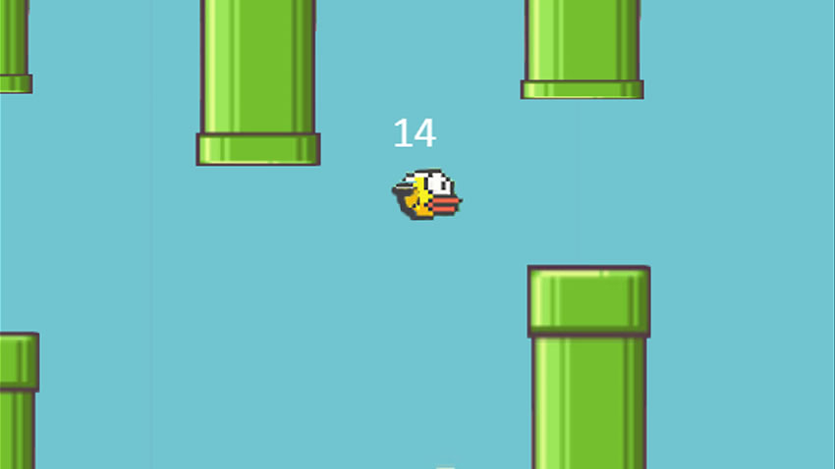
Score and endgame
The game ends as the count of obstacles avoided reaches 25. as the game progresses, obstacles become harder to manoeuvre.

Slide 7
Conclusion and future steps
Developing Flappy bird is a rewarding project that offers numerous benefits for both novice and experienced programmers. It serves as a practical introduction to fundamental programming concepts, game development mechanics, and problem-solving strategies. Through this project, developers gain hands-on experience in creating a functional, enjoyable game that can be enhanced and customized in various ways.
For our project 2 review – we’ve made the game functional. For our next review, we will add a database for player high score, limitless level and potentially new mechanics.

Slide 8
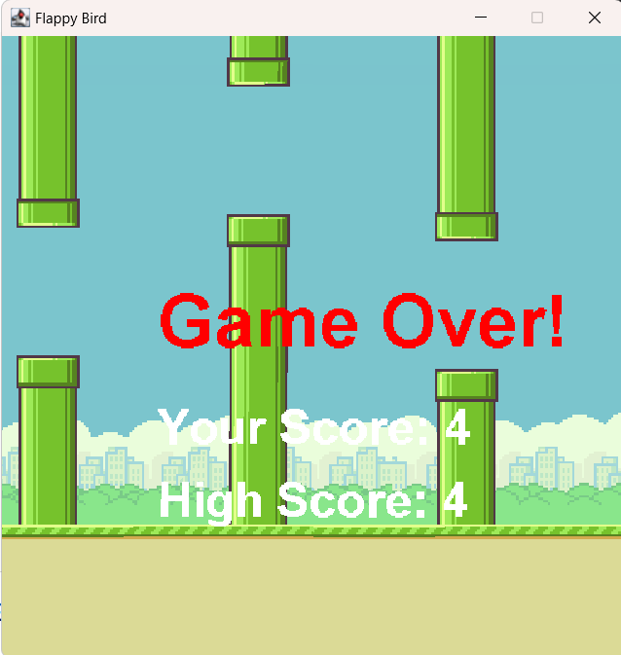
HIGHSCORE AND DATABASE
The Game Over screen displays the current run’s score and the highest score. You can also break the record and have your score displayed as the highest.

Slide 9
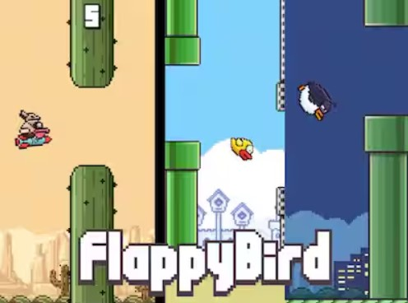
THANK YOU

